Slide 1
Adult Income Dataset
Story Telling

Slide 2
Adult Income Dataset Details
This Dataset contains 48842 rows and 14 columns
Dataset have features like age, working class, education, marital status, occupation, relationship, race, gender, capital gain, capital loss, working hours per week, country and income .
Income is classified into two class one is less than 50K and other one is greater than 50K.
This dataset explains the income variation across countries , the features which contribute more to income and relationship between the income and various factors like age, education, working class etc.
This story tells about the factors contributing to income and how its correlated with other factors.

Slide 3
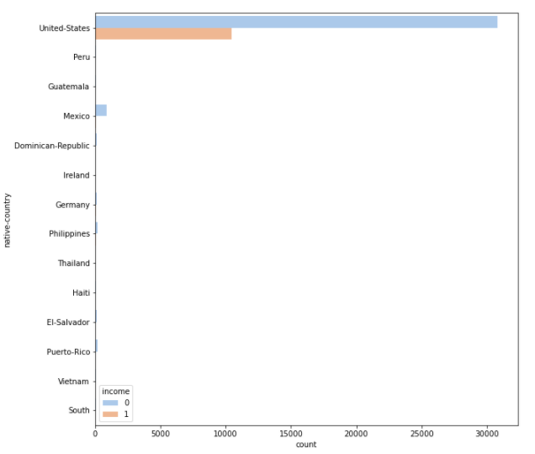
Income in various countries
Here we can observe the United States predominating the graph.
“income 0” represents income less than 50K and “income 1” represents vice versa.
In US more people come under the category “income 0” that is almost 3 times of the people who are earning more than 50K according to this dataset.

Slide 4
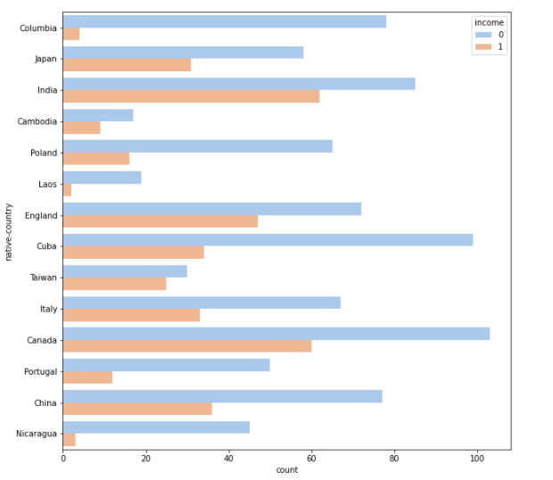
In this graph we can observe mostly in all countries the people who earns less than 50K is more than people earning greater than 50K.
Canada, England coming under developed nations and India standing as developing country both have more number of people earning more than 50K when compared with other countries.
Laos from Asia and Nicaragua from central America have less people earning more than 50 K .

Slide 5
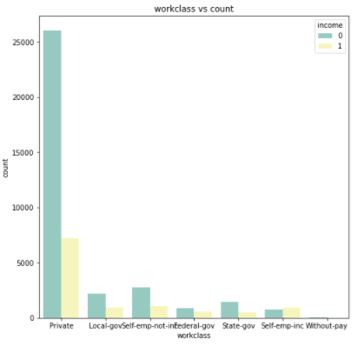
Work class VS Income
The people who works in private firms earns more than the people who works in other firms.
Number of people working in private firm is more than all firms and even when we add people count of all the firms , the people in private firm count is more.

Slide 6
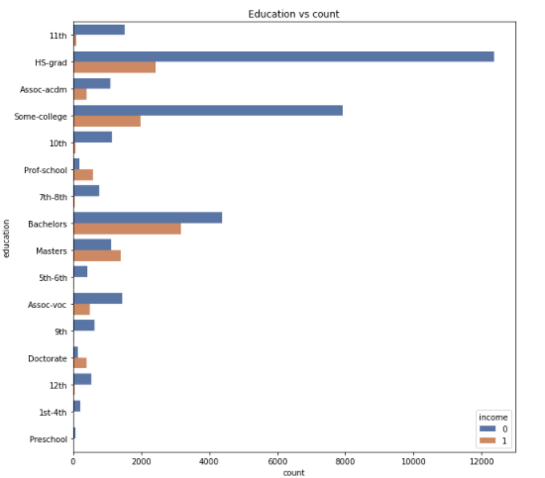
Education Correlation with Income
From this graph we can observe High School grad count is high.
People with Bachelors degree earns more and the count of people who earns more than 50K is slightly high compared to other degree holders

Slide 7
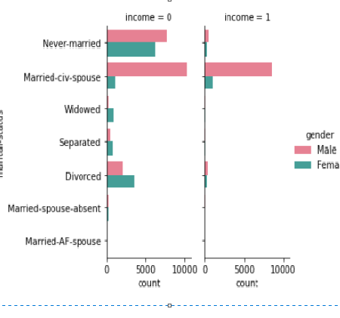
How marital status correlated with Income
The men who is married with civilian spouse count is more in the side who is earning more than K .
Marriage-civ-spouse count is same for both sides (income = 0 and income =1)
Never married people who earns less than 50K is more when compared to people with same marital status who earns more than 50K
Divorcee count is more in female and the divorced people count is more in income less than 50K

Slide 8
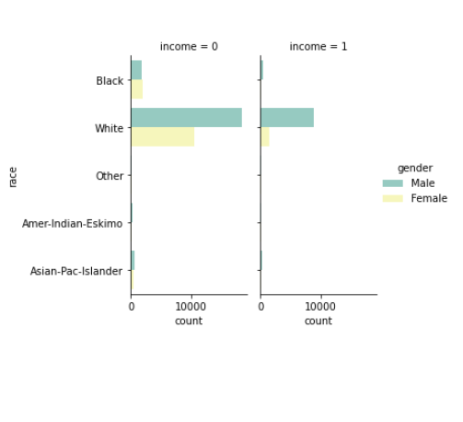
Race Vs Income
Whites count is more in both sides of the income
Blacks count is more in the side who earns less than 50 K.

Slide 9
Conclusion
The income level varies with the countries

